Slide 1
DevOps & Cloud Infrastructure SEIS 665 Deployment Pipelines
Jason Baker
Adjunct Instructor
Graduate Programs in Software
University of St. Thomas
St. Paul, MN

Slide 2
Agenda
Deployment Pipelines
Jenkins
Pipeline-as-Code

Slide 3
Deployment Pipeline
A deployment pipeline is used to manage the deployment and testing of software using a set of validation stages whenever there is a code change.
Commit
Linting
Build
Test
Deploy

Slide 4
Pipeline Benefits
Software is automatically built and tested.
Ready to go to production at any time.
Making changes to software is much easier.
Every change is tested the same way
Easier to automatically deploy changes versus using manual methods
Reinforces practice of using small batch sizes
Compliance and governance tasks are easier.
Traceability improved and tests are enforced.
Reduces need for heavy change control tasks.

Slide 5
Real World Pipeline Development
Some companies hire people to focus exclusively on pipeline development work.
CI/CD engineers
Software Delivery engineers
DevOps Engineer
Release Engineer
Build Engineer
Software engineers today have to know how to build pipelines.

Slide 6
Basic Pipeline Design
Local development stage
Developers run and test software on their local workstation
Natively, virtual machine (vagrant), container
Linting: a static code analysis process which identifies common syntax and style defects using a linter application.
Unit testing: functional tests performed at a small, modular level.

Slide 7
Basic Pipeline Design
Build stage
Usually triggered when a developer checks new code into a VCS
Linting process
Code compilation (when necessary)
Unit tests
Possible local execution tests
Package code and store in an artifact repository

Slide 8
Basic Pipeline Design
Testing stage
Code artifact is deployed to a testing environment
Automated API and/or GUI tests are run against environment
Both integration and end-to-end testing
May leverage a grid-based testing solution
Non-functional testing (service resiliency)
Performance testing
Manual testing (pipeline is stopped and manually retriggered)

Slide 9
Basic Pipeline Design
Production deployment stage/ release
Code artifact is deployed to production environment
May be first applied to a staging environment for further testing before production
Automated smoke tests are run against deployment to validate application working properly.

Slide 10
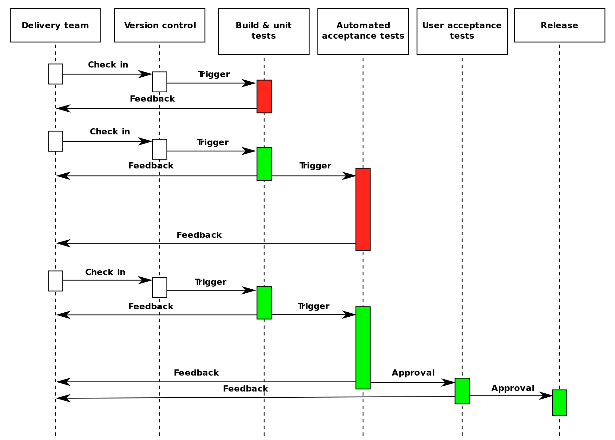

Slide 11
Deployment Pipeline Practices
Prove production-readiness for every change
All changes are potential releasable.
Only build your binaries once.
Don’t keep re-compiling or packaging app at each stage to minimize introduction of configuration inconsistencies.
Store application artifacts in a repository (example: Artifactory)
Deploy the same way to every environment.
Use the same script to deploy to a dev laptop, a test virtual machine, and a public cloud instance.
Store environment-specific configurations in separate files.
If any part of the pipeline fails, stop the line.
If a deployment to an environment fails, the whole team owns that failure and every effort should be taken to fix it.

Slide 12
Fan-in Pipeline Pattern
Multiple pipelines may feed a single assembly or deployment pipeline.

Slide 13

AWS CodeStar
A cloud development environment which allows developers to write, build, and deploy applications.
Cloud9
CodeCommit
CodeBuild
CodeDeploy
CodePipeline

Slide 14

Cloud9
A cloud-based integrated development environment (IDE).
Text editor for writing Python, PHP, Javascript, etc.
Build and test application code.
Easy command-line access to AWS API.
Team collaboration features.

Slide 15
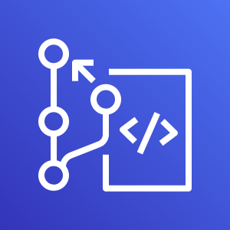
CodeCommit
A managed Git version-control service.
It's like a lighter version of GitHub.
Free tier works well for small teams (5 or less).
Why do we use GitHub instead of CodeCommit?
GitHub Classroom features
CodeCommit may work just fine for your projects.

Slide 16
CI/CD pipeline infrastructure
Building and maintaining CI/CD infrastructure is challenging:
Install and update CI server (Jenkins, Bamboo, etc)
Manage CI server settings
Install and update plugins
Create, update, and scale build node servers
May need multiple types of build nodes for various jobs
Don't forget about backups and security!
Companies oftentimes have dedicated engineers and teams to focus on supporting this infrastructure.
AWS can handle many of these challenges for us.

Slide 17
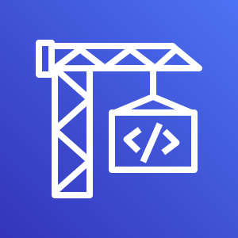
CodeBuild
Managed continuous integration service which allows you to compile code, run unit tests, and create deployment artifacts.
No need to provision or manage build servers.
Automatically scales computing resources to meet demand.
Use pre-packaged environments or bring your own.
Java, Python, Node.js, Ruby, Go, Android, .Net Core, Docker
Billed by the minute for time to complete your build and compute resources used.
Free tier: 100 build minutes of build.general1.small instance/month.

Slide 18
CodeBuild
CodeBuild uses a build project to define how to run a build.
Defines where the source code is located.
What build environment to use
Set of build commands to run
Where to store the build output artifacts
A build environment specifies:
Operating system
Programming language runtime
Tools
During a build, a build environment is created and source code is downloaded into the environment.

Slide 19
CodeBuild
A build specification (build spec) defines the commands which CodeBuild uses to run the build.
We use a YAML file called buildspec.yml located within the root directory of the source code repository to store the build spec.

Slide 20
CodeBuild buildspec.yml
version 0.2
env:
variables:
key: "value"
phases:
pre_build:
commands:
- echo Nothing to do in the pre_build phase…
build:
commands:
- echo Build started on `date`
- mvn install
finally:
- echo Run this even if the build commands fail.
post-build:
commands:
- echo Build completed on `date`
artifacts:
files:
- target/myApp.jar
name: myApp.jar-$(date +%Y-%m-%d)

Slide 21
CodeBuild buildspec.yml
buildspec.yml file always starts with a version
version 0.2
You can set environment variables during the build:
env:
variables:
key: "value"

Slide 22
CodeBuild buildspec.yml
The build process is partitioned into one or more phases:
install: used for installing packages into the build environment
pre_build: run command before the build such as installing node dependencies
build: commands for the actual build process
post-build: commands run after the build such as packaging output artifacts into a WAR or zip file
Commands are shell script statements, and the build process will end if any of the commands fail.
The finally block of commands will always run even if any of the build commands fail.
phases:
build:
commands:
- echo Build started on `date`
- mvn install
finally:
- echo Run this even if the build commands fail.

Slide 23
CodeBuild buildspec.yml
The artifacts section describes where the output artifacts are located and optionally what to name these artifacts after copying.
Artifacts are stored in an S3 bucket.
artifacts:
files:
- target/myApp.jar
name: myApp.jar-$(date +%Y-%m-%d)

Slide 24
Jenkins
An open-source automation server written in Java.
Started at Sun Microsystems in 2004 and known as the Hudson project.
Forked in 2011 after Oracle bought Sun Microsystems and renamed Jenkins.
Commercial version available from CloudBees.

Slide 25
Jenkins key terms
Jobs: define a specific set of tasks (workflow) which Jenkins will execute.
Workspace: a directory location on a Jenkins-managed system were a job will execute.
Executors: refers to the number of concurrent jobs that will run on a Jenkins system.
Environment variables: key/value pairs which a running job can use as input parameters.
Plugins: software modules which expand Jenkins functionality.

Slide 26
Jenkins interface
Review key parts of Jenkins interface:
Navigation menu
Top breadcrumb menu
Build history
Build Executor status
Job status

Slide 27
Jenkins plugins
Most of the functionality in Jenkins is provided by plugin modules
Manage Jenkins -> Manage Plugins
The plugins manager shows installed and available plugins.
Sometimes Jenkins must be restarted after a plugin is installed.
Two different implementations of Jenkins could look very different depending on the plugins installed!

Slide 28
Jobs
Let’s create a project.
Freestyle project called: show-environment
Add a description: show all environment variables
Add an execute shell build step:
env | sort
Build the project
Look at the build output.
Review the Build History within the project and on the dashboard.
Note current build status and ”weather” report.

Slide 29
Jobs
Let’s update the show-environment project.
Add another command to the build step:
Execute shell
env | sort
false
Build the project
Notice that the build now fails (purposely) and look at the console output.
Review the Build History within the project and on the dashboard.
Note new build status and cloudy ”weather” report.

Slide 30
Jobs
Let’s fix the project by removing the false command.
Add a command to the build step to output the current build number:
Execute shell
env | sort
echo "Working with build ${BUILD_NUMBER}"
Build the project
Check out the build output.
The ${variable} syntax provides variable interpolation within Jenkins.

Slide 31
Fork a Github repository
Let's setup a GitHub repo that Jenkins can work with.
Click the following link and fork a copy of a Java GitHub project into your personal account:
https://github.com/seis665/java-project

Slide 32
Java Project
Create a new freestyle project called: my-java-project
Configure the project settings and specify the GitHub project url
https://github.com/<github_username>/java-project/
Configure a Git repository under Source Code Management settings:
Repository URL
https://github.com/<github_username>/java-project.git
No need to set credentials here because the repository is public.
Save the configuration (no need to add any build steps) and build the project.
Look at the console output to see that Jenkins automatically pulled the repository.

Slide 33
Java Project
Let’s setup our project to automatically build our java code using Ant.
Apache Ant is a build manager for Java projects.
Modify the project configuration:
Execute shell command:
ant
Run the build and take a look at the console output.
Also, look at the workspace to see the build artifacts.

Slide 34
Java Project
We really don’t want to create build artifacts without testing our code first.
Go to the project configuration and add a build step that will run prior to our existing ant execution.
ant -buildfile test.xml
Run a new build and look at the console output to verify that the tests ran correctly.

Slide 35
Java Project
It would be nice to see the test results in a more visual format.
Go to the project configuration and add a post-build action:
Publish Junit test result report:
Test report XMLs: reports/*.xml
Run a new build and then look at the project main page.
Notice the Latest Test Result report.
Now, run another build and look at the project main page.
Jenkins will produce a trending test graph for your project.

Slide 36
Build Trigger
Most of the time we want to trigger builds based on an event -- like a new git commit.
Go to the Github forked java-project repository and setup Jenkins integration:
Settings -> Webhooks
Add webhook
Payload URL: http://<server IP>:8080/github-webhook/
Use the content type default setting and leave the secret empty
Trigger the webhook just on push events.
Save by clicking on the "Add webhook" button.

Slide 37
Build Trigger
GitHub will send push notifications to our Jenkins server, but the project needs to be triggered.
Go to the my-java-project configuration:
Build Triggers
Check: GitHub hook trigger for GITScm polling
Go to the java-project GitHub repo and make a small change to the README.md file and check it in.
Watch Jenkins automatically build the project!

Slide 38
Jenkins Slave Nodes
Our build jobs have been running directly on the Jenkins server (master).
This is not a recommended practice.
Jenkins supports multiple slave build nodes.
Each node has a label (example: linux) and can support different types of build jobs.
Your environment has one slave node which supports ant and AWS CLI operations.

Slide 39
Pipeline-as-Code
Traditionally we would create pipelines by defining jobs (stages) manually and linking them together.
Now it’s possible to define a pipeline using code instead of configuration.
Automate everything, including the configuration of our pipelines!

Slide 40
Jenkins Pipeline DSL
Benefits:
Job configuration is kept in the same place as source code.
Pipeline configuration is versioned.
Provides greater customization and control over pipelines.
Promotes sharing and reuse of pipeline configurations.

Slide 41
Jenkins Pipeline DSL
Pipeline code is stored in a Jenkinsfile which is usually located in the root folder of a repo.
The Pipeline DSL is based on the Groovy language.
Groovy compiles and runs on JVM.
Two types of Jenkinsfile pipelines: declarative (future direction) and scripted (in-line code).
We’ll use declarative pipelines in this course.
Although I’ve only used scripted pipelines in practice.

Slide 42
Jenkins Pipeline terms
Step: a single task which tells Jenkins to do something.
Node: tells Jenkins where to run the task.
Agent: indicates that Jenkins should allocate an executor and workspace for the pipeline.
Stage: a step which defines a distinct subset of the pipeline (build, test, deploy)
A stage will have one or more steps.

Slide 43
Jenkinsfile example
pipeline {
agent any
stages {
stage(‘Build’) {
steps {
sh ‘ant’
}
}
stage(‘Test’) {
steps {
junit ‘reports/*.xml’
}
}
}
}

Slide 44
Pipeline DSL syntax
sh: run a shell command
sh ‘env | sort’
dir: run code steps within a directory
dir(‘mydirectory) {
//some code
}
git: checkout a git repo into a workspace
git 'https://github.com/jasondbaker/java-project.git’
echo: print a message
echo ‘this is a message’
withEnv: run code steps with specific environment variables set
withEnv(['MYVAR=FOO']) {
// some block
}

Slide 45
Pipeline project
Create a new pipeline project called: java-pipeline
Define GitHub project
Project url: https://github.com/<username>/java-project
Build trigger: GitHub hook trigger for GITScm polling
Pipeline
Select Pipeline script

Slide 46
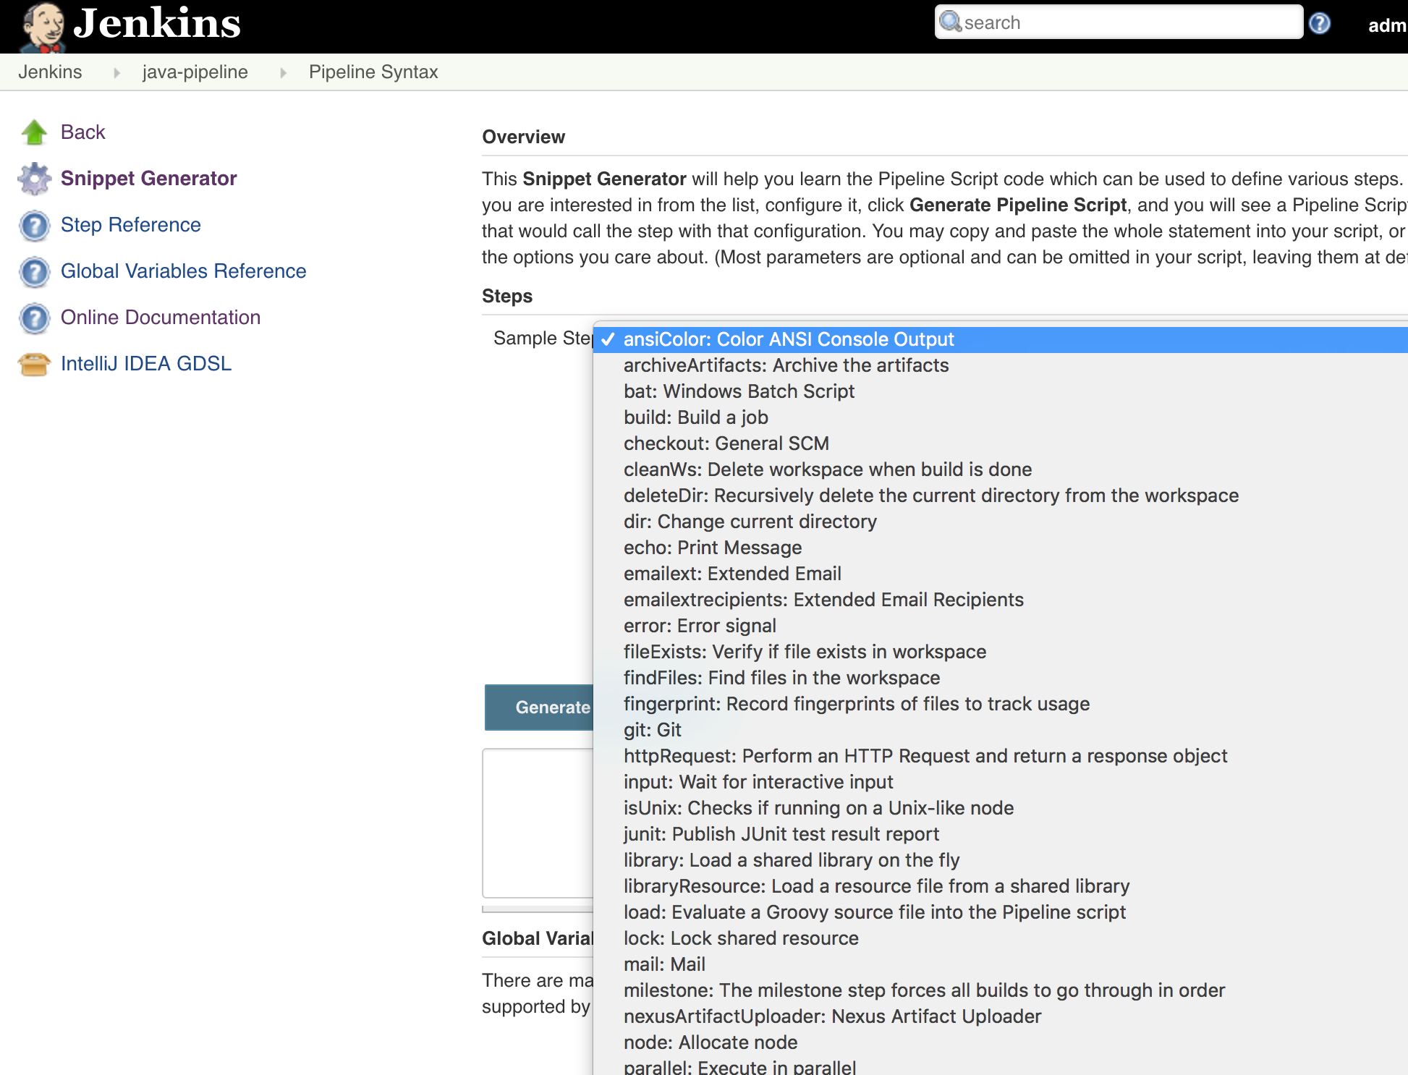
Pipeline DSL syntax
Pipeline code snippet generator

Slide 47
Pipeline script
pipeline {
agent { label 'linux' }
stages {
stage('Test') {
steps {
git 'https://github.com/<github_username>/java-project.git'
sh 'ant -buildfile test.xml'
}
}
stage('Build') {
steps {
sh 'ant'
}
}
stage('Results') {
steps {
junit 'reports/*.xml'
}
}
}
}

Slide 48
Pipeline project
Run the java-pipeline build manually and verify successful build.
We have to run it manually first time to setup pipeline GitHub trigger.
Next, go to the java-project GitHub repository and make a change to the README.md file.
Watch job automatically execute pipeline.

Slide 49
Pipeline Jenkinsfile
Go back into the java-pipeline project configuration.
Let’s automatically build from a Jenkinsfile instead of a script.
Pipeline
GitHub Project Url: https://github.com/<username>/java-project
GitHub hook trigger for GITScm polling
Select Pipeline script from SCM
Pipeline Script from SCM: Git
Repository url: https://github.com/<username>/java-project.git
Script Path: Jenkinsfile

Slide 50
Pipeline Jenkinsfile
Go to java-project GitHub repo, add a Jenkinsfile with pipeline code, and watch pipeline automatically execute.
We can remove git command from pipeline script because repo configured in job.
Build job once manually to set webhook trigger.
pipeline {
agent { label 'linux' }
stages {
stage('Test') {
steps {
sh 'ant -buildfile test.xml'
}
}
…
}

Slide 51
Troubleshooting Pipelines
Iteratively making changes to Git repo to trigger a pipeline is tedious.
Jenkins provides ability to replay a pipeline.
Click on the Replay link in a recent build for the java-pipeline project.

Slide 52
Accessing Private Repository
Jenkins has been cloning our github repository without providing any credentials.
We've been using public repositories so far.
Accessing private repositories requires three steps:
Setup a GitHub personal access token
Configure the pipeline git configuration to use this credential
Pass the token to the git command inside the pipeline script.

Slide 53
Jenkins-Github Private Repos
Generate GitHub personal access token
Log into GitHub
Go to Settings -> Developer Settings -> Personal access tokens page
Generate a new personal token
Description: Personal jenkins access
Required permissions:
admin:repo_hook
repo
repo:status
Copy generated token and store in safe place
Manage Jenkins -> Configure System
Select your pipeline configuration, and locate the Add button next to the Git server credentials.
Click Credentials add button and select Jenkins provider:
Kind: Username with password
Username: your GitHub username
Password: the GitHub personal access token
Description: GitHub token
Save the credentials and select the GitHub token credential in the drop-down field. Jenkins will try to authenticate with GitHub.
Save the pipeline configuration

Slide 54
Jenkins-Github Private Repos
The pipeline is now able to access the private repository to retrieve the Jenkinsfile.
However, since the script in the Jenkinsfile tells Jenkins to clone the repository, the script also needs to provide credentials.
Easiest way to figure out the git command syntax in the pipeline script is to use the Pipeline Syntax editor:
Click on the Pipeline Syntax link at the bottom of the pipeline configuration page.
Select the git: Git sample step.
Type in your repository URL (ending with .git)
Select the GitHub token credential you created earlier.
Click the Generate Pipeline Script button, and copy-and-paste the resulting code into your Jenkinsfile script.

Slide 55
Infrastructure Pipelines
CI/CD pipelines aren’t just used to build software, we also use them to build infrastructure.
Two general use cases:
Automate testing of our infrastructure.
A change to a configuration management or infrastructure definition script triggers a pipeline.
Automate deployment of infrastructure and our software.

Slide 56
Infrastructure Pipeline
CloudFormation template pipeline example:
Lint CloudFormation template to validate syntax
Deploy CloudFormation template
Wait for AWS resources to be built
Test AWS resources to verify that required resources are installed and working properly
Terminate AWS resources
Publish new template

Slide 57
Jenkins AWS Credentials
Jenkins must have access to AWS Credentials in order to create AWS resources.
Jenkins supports an encrypted internal credentials store.
We used this earlier to store the GitHub token.
Setup IAM account in AWS for Jenkins.
IAM user name: jenkins
Access type: programmatic
Create group: jenkins
Access policy: PowerUserAccess
Copy Access key ID and Secret key to temporary safe place

Slide 58
Jenkins AWS Credentials
Now let’s add AWS credentials to Jenkins credential store.
Credentials -> Jenkins Store -> Global Credentials
Click Add Credentials link
Kind: AWS Credentials
Description: AWS keys
Access Key ID: (paste your ID)
Secret Access Key: (paste your key)

Slide 59
Infrastructure project
Create a new pipeline project called: aws-test
Let’s use the AWS CLI command to list all the resources associated with our jenkins CloudFormation stack.
The command we need to use is:
aws cloudformation describe-stack-resources --stack-name jenkins
And here’s the pipeline script code:
pipeline {
agent { label 'linux' }
stage ('Test'){
steps {
sh 'aws cloudformation describe-stack-resources --stack-name jenkins --region us-east-1'
}
}
}

Slide 60
Infrastructure project
Build the aws-test pipeline (trigger manually).
Check the console output to see why it failed.
The pipeline doesn’t work and it looks like it is failing because of missing credentials.
Remember, Jenkins creates a new environment to run this job so our AWS credentials need to be injected into this environment.

Slide 61
Infrastructure project
Let’s add the AWS credentials to the build environment using the withCredentials pipeline command.
Open the aws-test project configuration:
Click on the Pipeline syntax link
Select the withCredentials step
Add the AWS access key and secret binding
Generate Pipeline script
Copy and paste this script code around the current sh step.

Slide 62
Infrastructure project
Example script (this won’t work on your Jenkins instance):
pipeline {
agent { label 'linux' }
stage ('Test'){
steps {
withCredentials([[$class: 'AmazonWebServicesCredentialsBinding', accessKeyVariable: 'AWS_ACCESS_KEY_ID', credentialsId: '14dd1bff-3295-4649-a919-3fc6ad57f627', secretKeyVariable: 'AWS_SECRET_ACCESS_KEY']]) {
sh 'aws cloudformation describe-stack-resources --region us-east-1 --stack-name jenkins'
}
}
}
}

Slide 63
Infrastructure project
Build the project again and it should build successfully.
Look at the build console output.
AWS returns a JSON object listing all of the stack resources.
It’s common to parse these JSON objects using Groovy code, pipeline script (readJSON), or shell applications (jq).
You will get to build an infrastructure pipeline in this week’s homework assignment.

